Slide 1


Micro-Credit Defaulter Model

Slide 2
PROBLEM statement
In a statement,The problem we will be exploring is binary classification (a sample can only be one of two things).This is because we're going to be using a number of differnet features (pieces of information) about a person to predict in terms of a probability for each loan transaction, whether the customer will be paying back the loaned amount within 5 days of insurance of loan. In this case, Label ‘1’ indicates that the loan has been payed i.e. Non- defaulter, while, Label ‘0’ indicates that the loan has not been payed i.e. defaulter.
Points to Remember:
• There are no null values in the dataset.
• There may be some customers with no loan history.
• The dataset is imbalanced. Label ‘1’ has approximately 87.5% records, while, label ‘0’ has approximately 12.5% records.
• For some features, there may be values which might not be realistic. You may have to observe them and treat them with a suitable explanation.
• You might come across outliers in some features which you need to handle as per your understanding. Keep in mind that data is expensive and we cannot lose more than 7-8% of the data.

Slide 3
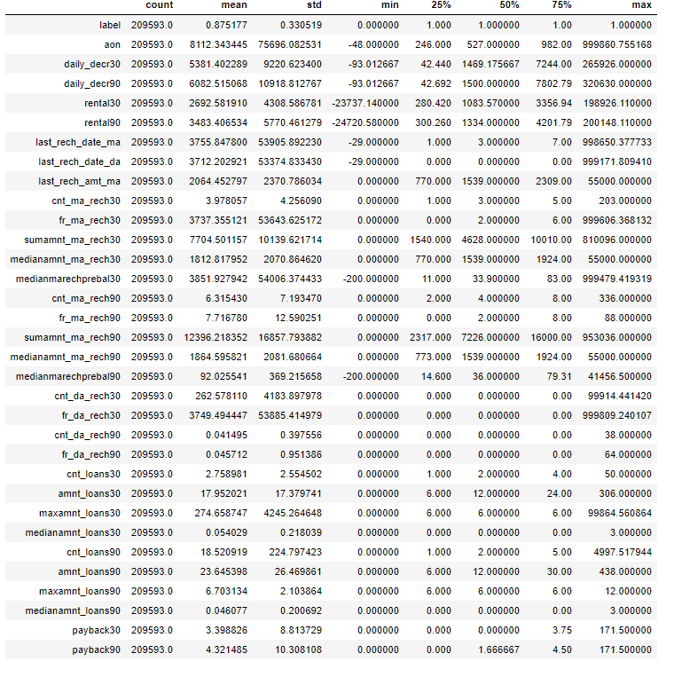
Analytical Problem Framing
From the above statistical summary of the above part of the dataset, we can see that the min value is negative which is not even possible for most of the features like daily recharge and main account balance, and last recharge can't be negative.
We created multiple group based on min, 25% to 75%, above 75% and we compared it VS payback within 5 days.
We identified the outliers for features whose Z-score>3, and then did mean imputing and also applied cube root to bring the data closer to distribution.
We checked the correlation of the independent and dependent features and dropped the negative and less important features with the help of correlation matrix.

Slide 4
Data Pre-processing Done
We checked the correlation of the independent and dependent features and dropped the negative and less important features with the help of correlation matrix.
There were data for 30 and 90 days, so considering data for 90 days is adding more information rather than then data of 30 days.
Some features can’t have any negative value, so those features were treated accordingly.
Outliers are treated manually for the features giving some important information, and then the threshold values were set to make the data freee from outliers.
Data lost is very less i.e less than the 7% which was stated in the documentation.
Applied SMOTETomek, to balance the dataset as the dataset was imbalanced dataset.
Applied StandardScaler to our dependent features.
Applied various machine learning model and compared it.
Applied hyper tunning several models, but couldn’t achieve much better results.
Saving final predictions in file.csv format

Slide 5
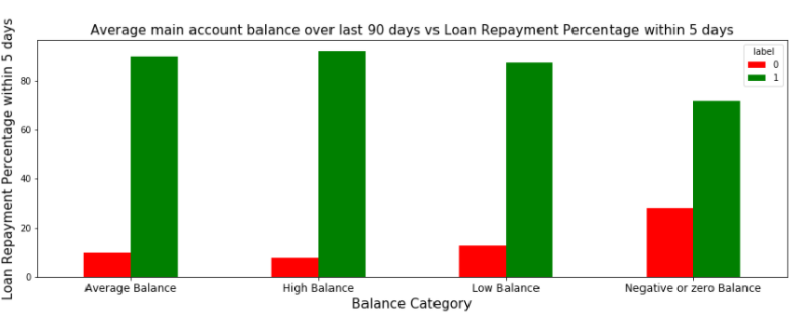
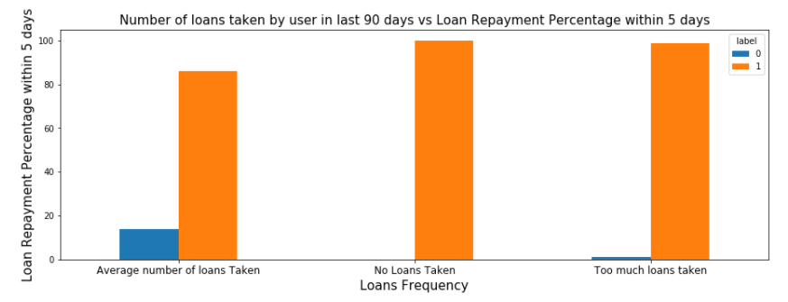
Data Inputs- Logic- Output Relationships

Slide 6
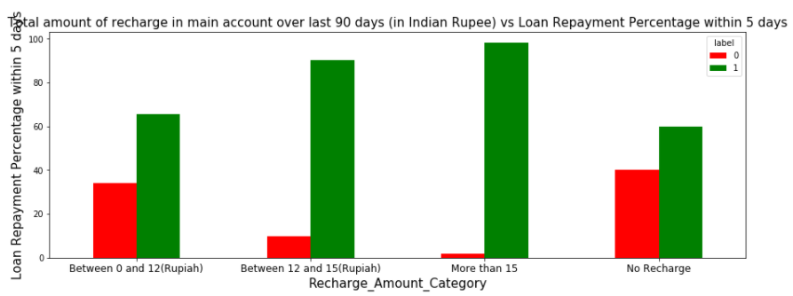
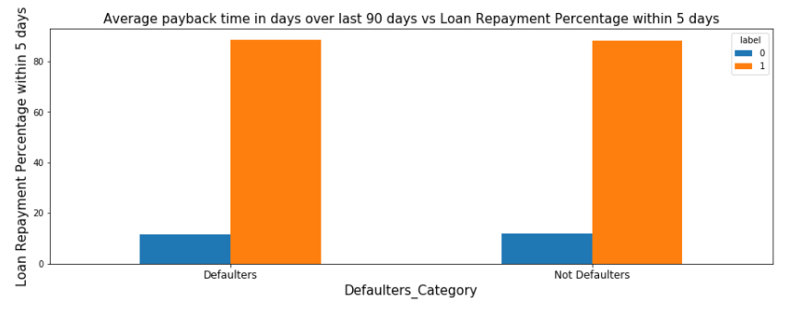

Slide 7
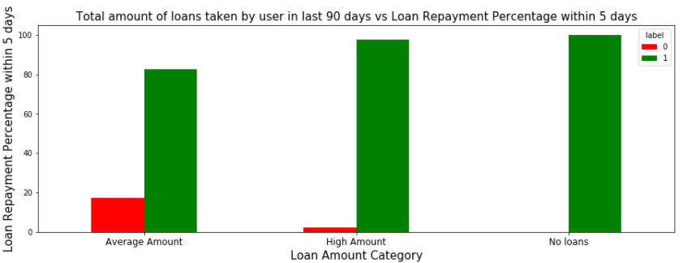
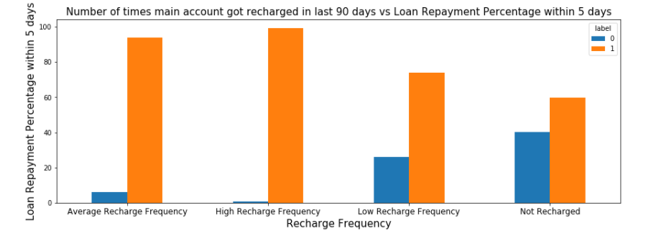
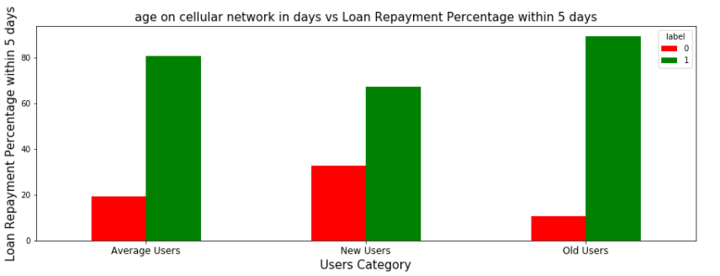

Slide 8
Model/s Development and Evaluation
Identification of possible problem-solving methods
As we seen the dataset is imbalanced i.e
Label ‘1’ has approximately 88.3% records, while, label ‘0’ has approximately 11.6% records.
So to make dataset balanced applied SMOTETomek.

Slide 9
Testing of Identified Approaches (Algorithms)
RandomForestClassifier
GradientBoostingClassifier
LogisticRegression
AdaBoostClassifier
ExtraTreesClassifier
XGBClassifier

Slide 10
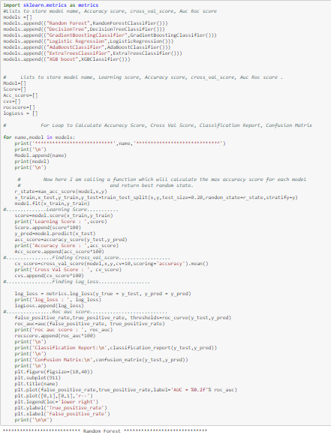

Slide 11
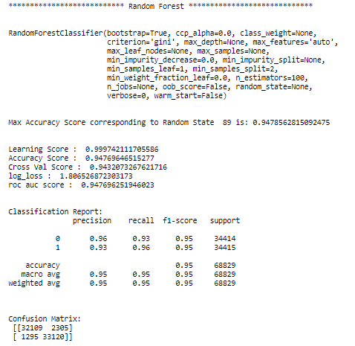
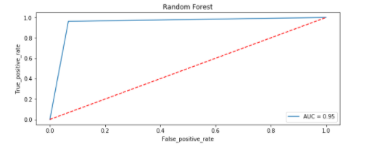

Slide 12
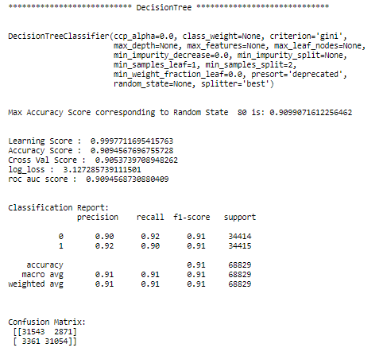
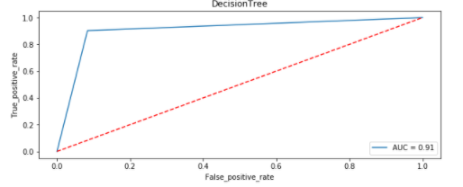

Slide 13
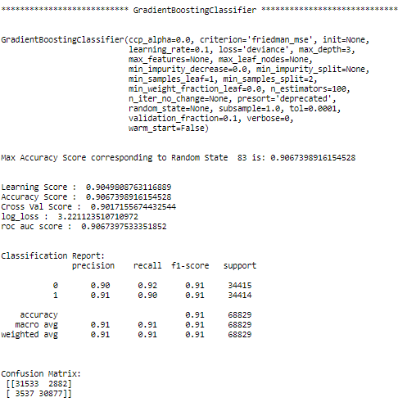
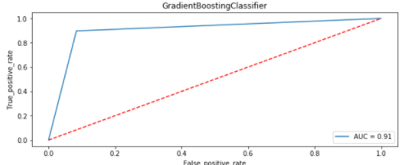

Slide 14
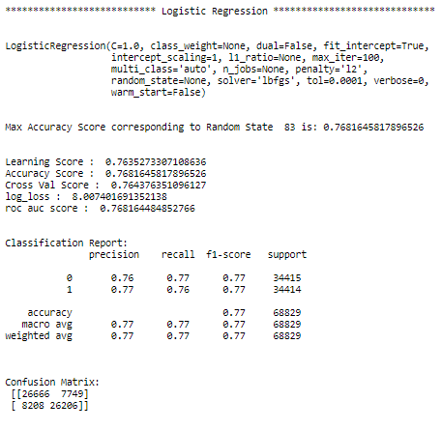
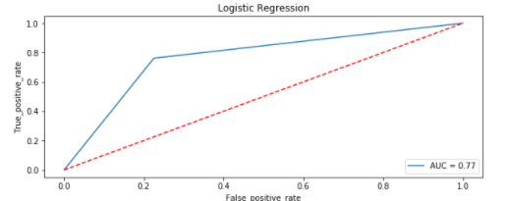

Slide 15
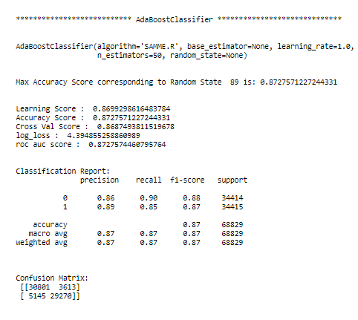
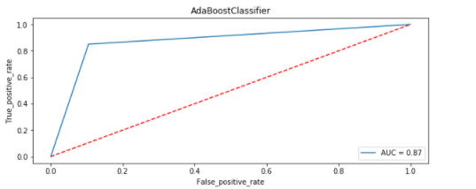

Slide 16
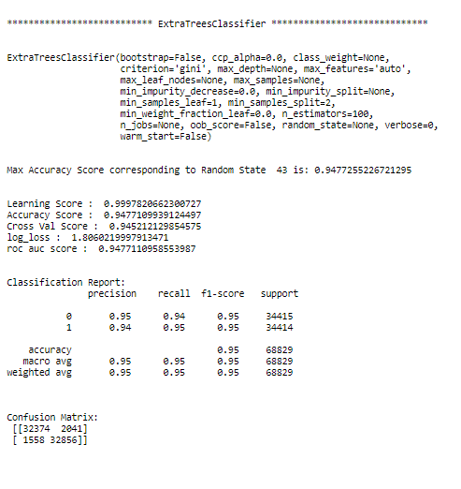
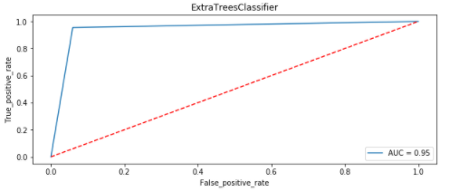

Slide 17
